Slide 1
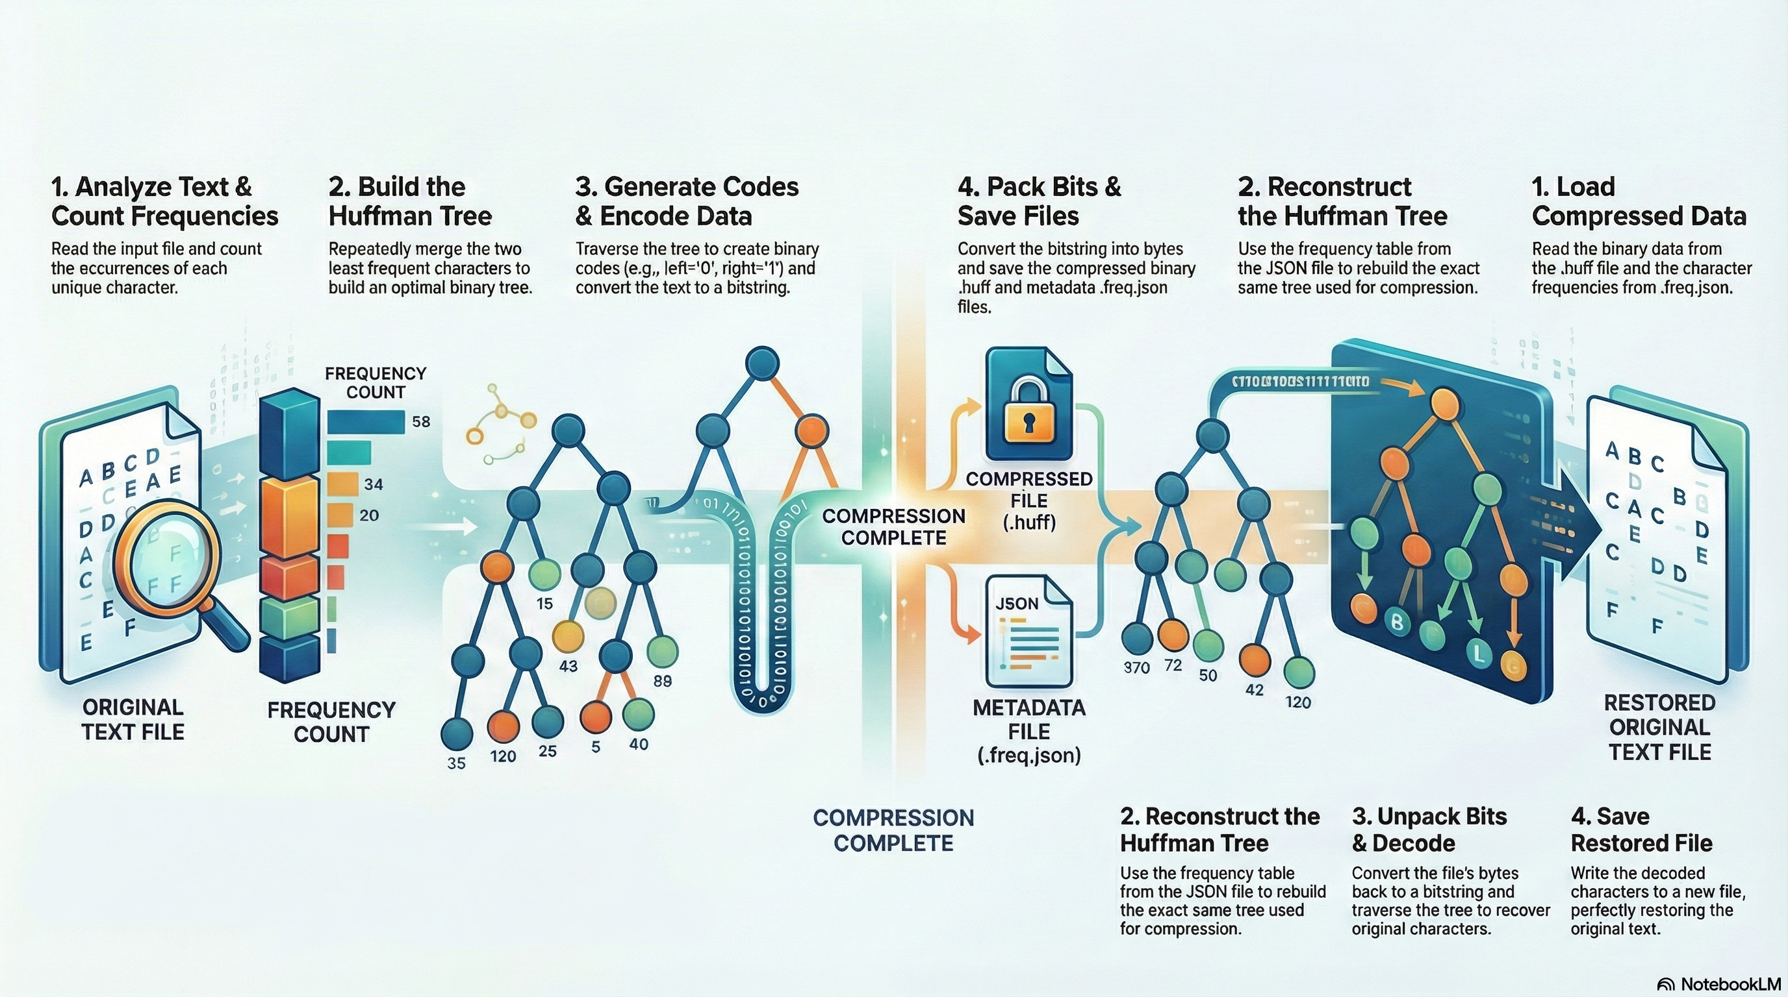
Huffman Coding: File/Text Compression using Greedy Algorithm
Northeastern University | CS5800 Algorithms | Prof. Aida Sharif Rohani
By
Bhalchandra Shinde
Shantanu Wankhare

Slide 2
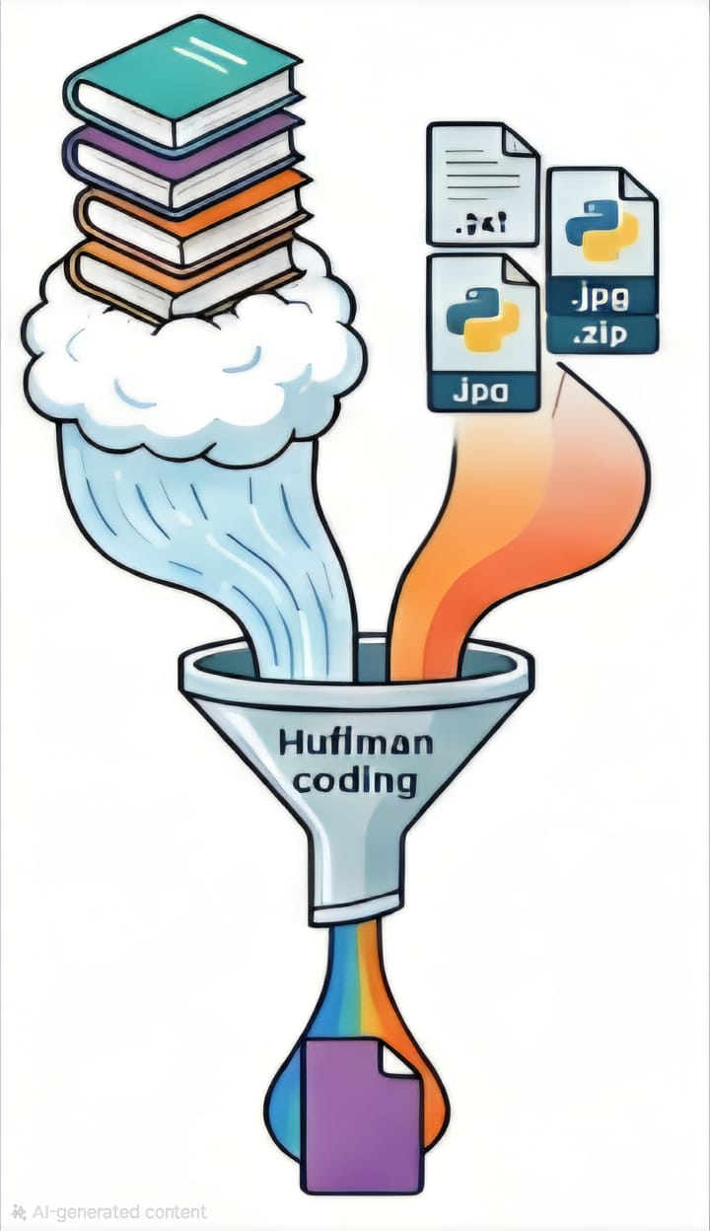
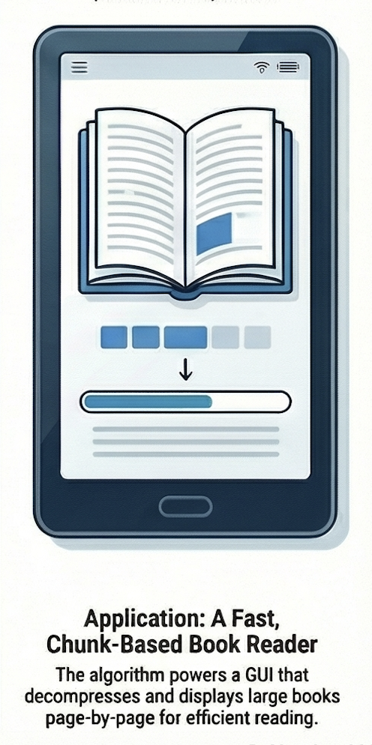
Huffman Coding
CS5800 Algorithms | Northeastern University
Introduction
Huffman tool
Reduce storage size without losing information.
Key Question.
How can we design a lossless compression system that significantly reduces text file size while enabling fast, real-time decompression for reading?
CONTEXT
Redundancy
Traditional text formats uses uncompression. It has most words/char repeated
Compression
Efficient compression is needed for text files as well.
Size
Digital text is produced and consumed at massive scale - ebooks, log, documents, research papers websites
Memory & Time
Storing and transferring large files is expensive
Reader Application
Decode compressed data efficiently enough to display pages of a book on demand.

Slide 3
Huffman Coding
CS5800 Algorithms | Northeastern University
So far Encodings
File Type | Extensions | Existing Compression / Encoding Method | Is File Already Compressed? | Expected Huffman Compression Ratio | Explanation
Plain Text | .txt, .log, .csv, .json, .xml | None | ❌ No | 40% – 80% smaller | Text has skewed character frequency; Huffman is ideal.
Documents (Office XML) | .docx, .xlsx, .pptx | ZIP (DEFLATE: LZ77 + Huffman) | ✔ Already compressed | File becomes 20–200% larger | Office files are ZIP containers; content already compressed using Huffman + LZ.
PDF | .pdf | Flate/DEFLATE, LZW, JPEG, JP2 | ✔ Already compressed | +20% to +300% expansion | PDF streams already use entropy coding; random-like distribution.
Images (raw) | .bmp, .ppm, .tiff (uncompressed) | None (sometimes RLE for TIFF) | ❌ No | 30% – 70% smaller | Raw pixel data compresses fairly well.
Images (compressed) | .jpg, .jpeg | DCT + Quantization + Huffman | ✔ Yes | Huge expansion: 300% – 800% | JPEG already uses Huffman coding inside. Compressing again makes it worse.
Images (compressed) | .png | DEFLATE (LZ77 + Huffman) | ✔ Yes | Very large expansion: 200% – 600% | PNG uses entropy coding and filters; nearly incompressible.
Audio (raw) | .wav, .pcm, .aiff | None | ❌ No | 10% – 40% smaller | Raw amplitude distributions slightly skewed; small gains.
Audio (compressed) | .mp3, .aac, .flac | MP3: MDCT + Huffman / AAC: Huffman / FLAC: Rice/Huffman | ✔ Yes | Massive expansion: 300% – 1000% | Audio codecs already use Huffman coding internally.
Video (raw) | .yuv | None | ❌ No | 10% – 30% smaller | Pixel values partly skewed; limited improvement.
Video (compressed) | .mp4, .mov, .mkv, .avi | H.264/HEVC/AV1 (CABAC, CAVLC, entropy coding) | ✔ Yes | Very large expansion: 200% – 800% | These codecs use advanced entropy coding more efficient than Huffman.
Python/Source Code | .py, .java, .cpp, .html, .css, .js | None | ❌ No | 30% – 70% smaller | High redundancy and repeated keywords; good for Huffman.
Binary Executables | .exe, .dll, .bin | Often packed or randomized | ⚠️ Sometimes | Likely expansion: 20% – 500% | Binaries include many random bytes or pre-packed segments.
Archives | .zip, .7z, .rar, .gz, .whl | DEFLATE, LZMA, PPMD | ✔ Fully compressed | Always expands | These formats already use Huffman, arithmetic coding, or LZ — cannot compress again.

Slide 4
Huffman Coding
CS5800 Algorithms | Northeastern University
Rationale
Huffman Coding is a classic Greedy Algorithm that produces an optimal prefix-free encoding based on symbol frequencies.
It is widely used in real systems (ZIP, JPEG, MP3), but classroom examples rarely show practical applications.
This project extends the Huffman algorithm beyond theory, building a complete working system:
A compression tool
A decompression module
A chunk-based paging system
A Python Tkinter based book reader
Why this matters:
Demonstrates how algorithmic theory can be used to build a real application.
Highlights trade-offs in designing usable compression systems (speed, memory, chunking, file formats).

Slide 5
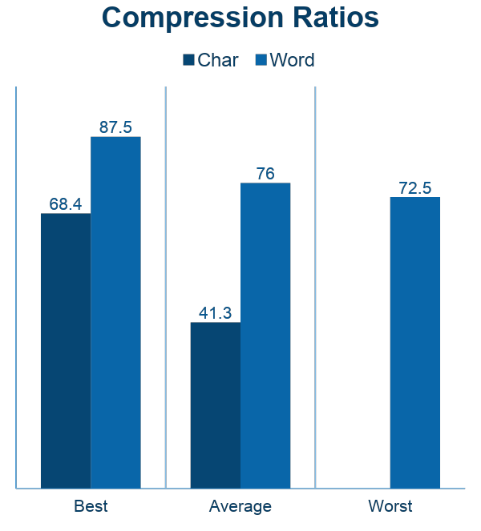
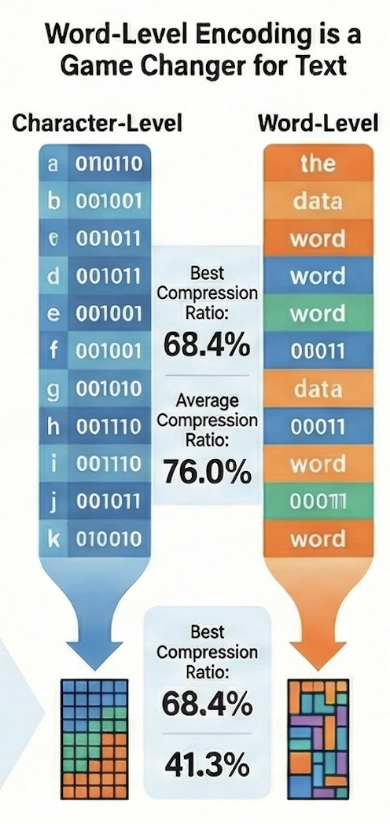
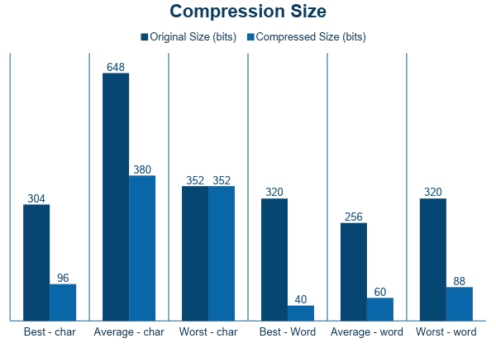
Huffman Coding
CS5800 Algorithms | Northeastern University
Analysis - Word level?
Character-level Huffman coding compresses but leaves redundancy: "the", "and", "to", "of" appear thousands of times.
Word-level encoding:
Dramatically reduces redundancy
Produces shorter average codewords
Improves readability after decoding
Works perfectly for book-style text
Compression improvement observed:
Word-level coding achieved up to 70% space savings vs raw .txt.

Slide 6
Huffman Coding
CS5800 Algorithms | Northeastern University
Pseudocode
COMPRESSION
Build frequency table (streaming)
Read file in chunks
Tokenize (char / word)
Build Huffman tree
heapq-based greedy merge
Generate Huffman codes
DFS traversal assigns 0/1 codes
Write codes report
Count frequencies
Stream encode input file
Symbol | Frequency | Code | Bits
Summary: sizes + ratio
Convert tokens → bitstring
Flush full bytes to output
Pad remaining bits (0–7)
Save → <filename>.huff
Save metadata
freq_table→ <filename>.huff.freq .json
visualize_tree(root) ← optional
Build Graphviz Digraph
Add node labels (char, freq)
Save as <filename>_tree.png
return success
DECOMPRESSION
Read compressed .huff file
Read 1st byte → padding value
Read remaining bytes → packed bitstream
Read metadata
Load <file> .huff.freq .json → freq.table
Rebuild Huffman tree
heapq-based merge using freq_table
Regenerate codes (reverse mapping)
DFS: char → code and code → char
Unpack encoded bits
Convert bytes → bitstring
Remove final padding bits
Decode bitstring
Traverse Huffman tree per bit
On reaching leaf → o/p symbol
Build decoded token list
Reconstruct final text
For char → join characters
For word → detokenize words/ punctuation
Write output text
Save → uncompressed_<file> .txt
return success

Slide 7
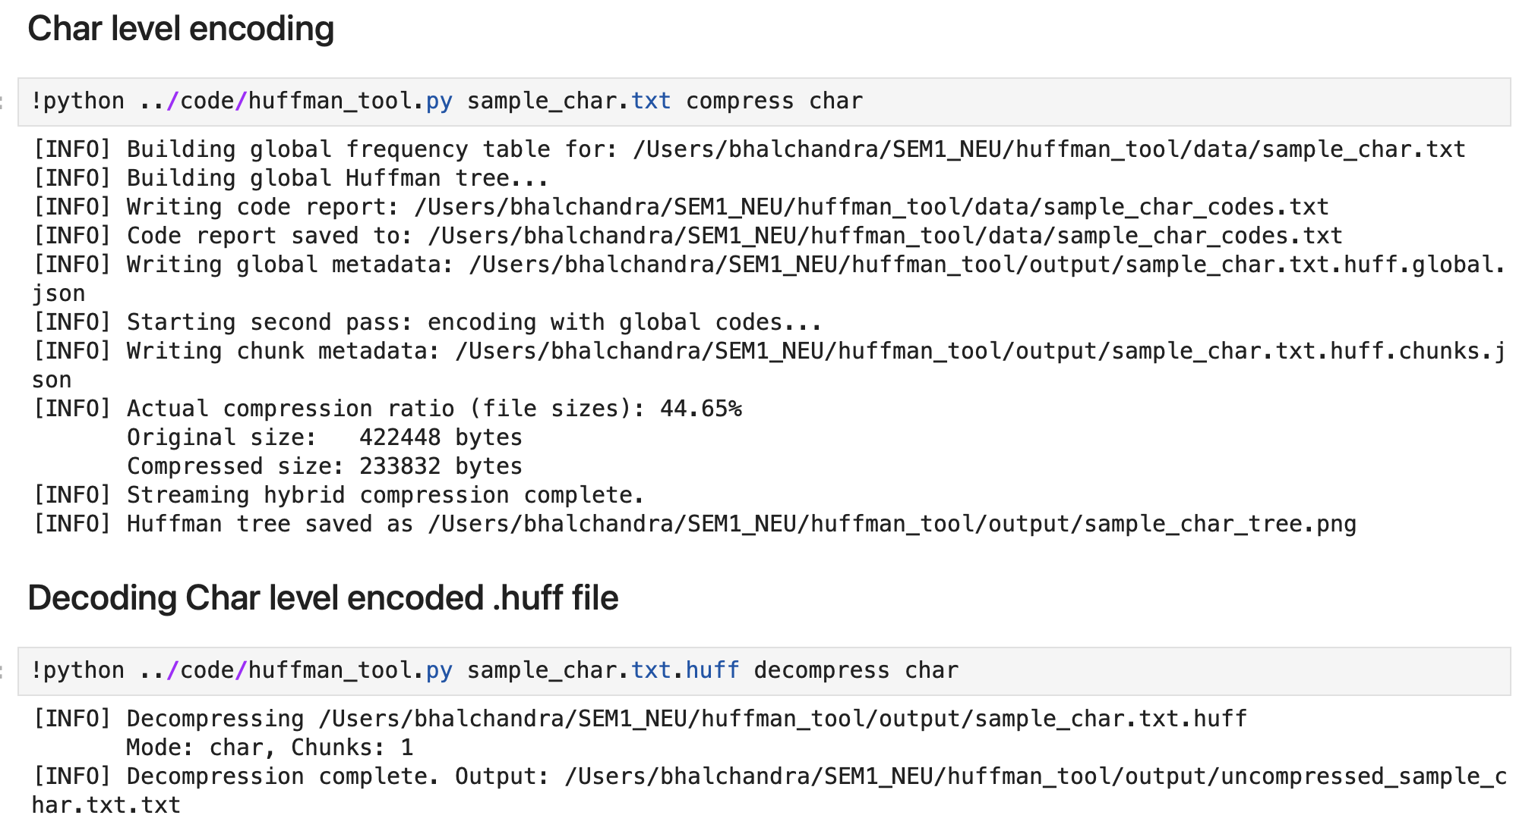
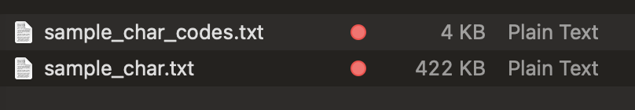
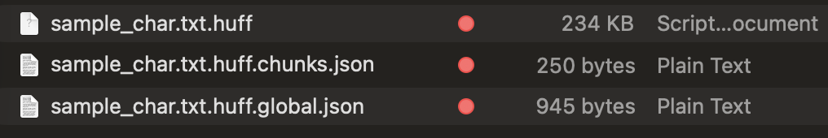
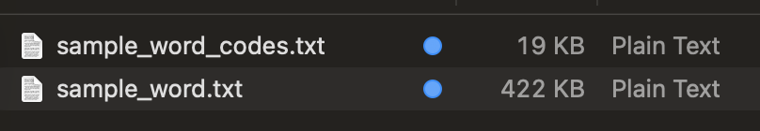
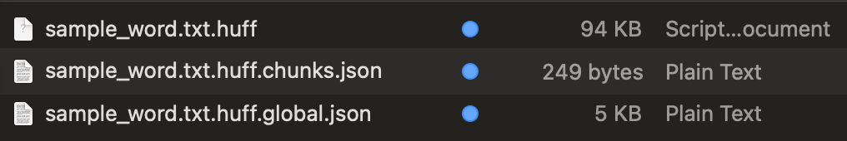
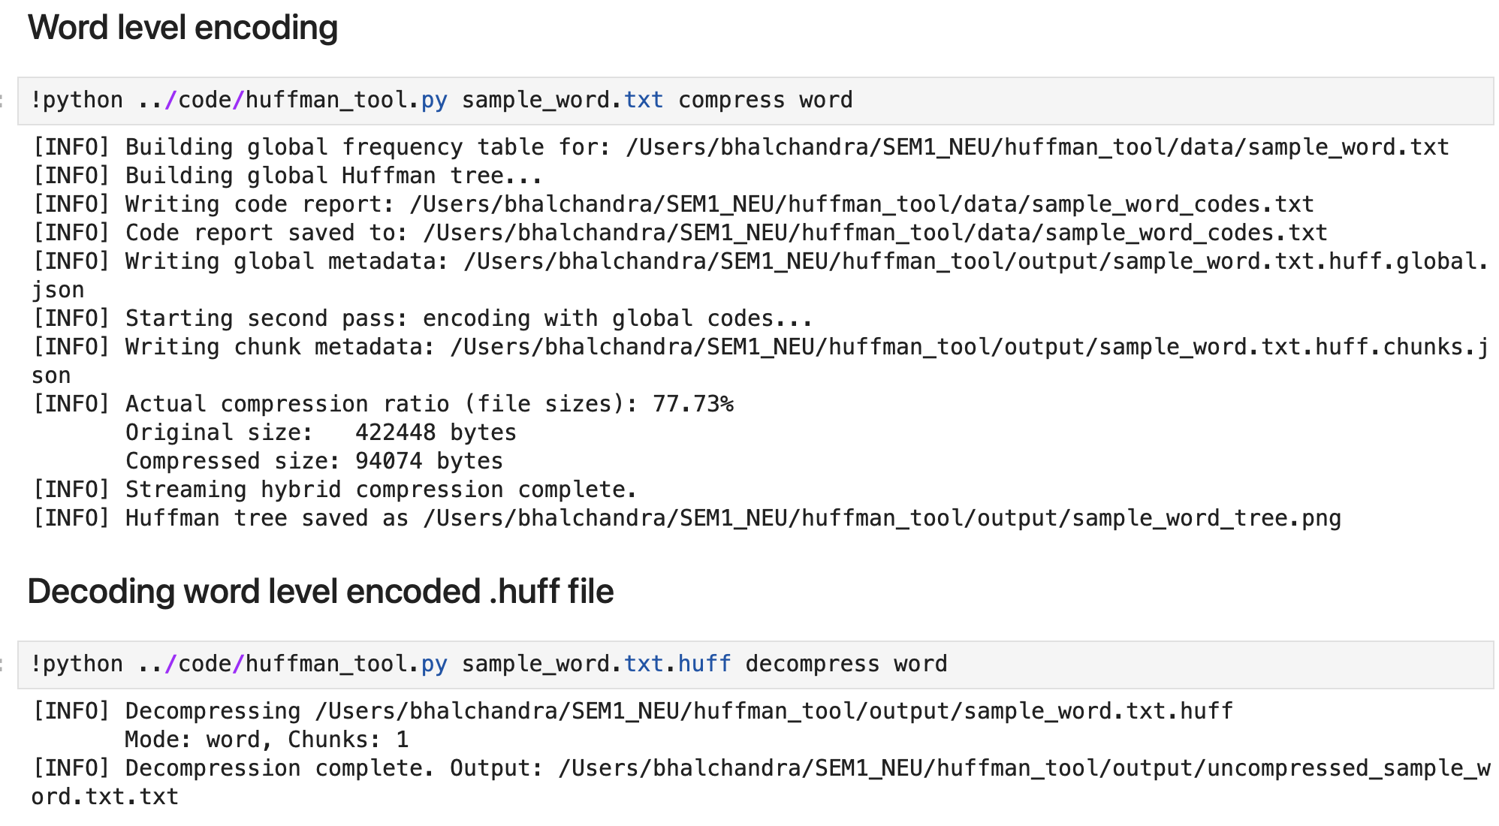
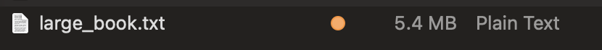
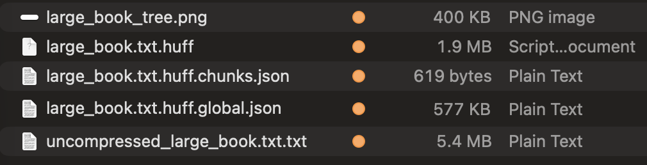
Huffman Coding
CS5800 Algorithms | Northeastern University
Tool Execution

Slide 8
Huffman Coding
CS5800 Algorithms | Northeastern University
Reader - pseudocode
FUNCTION ShowPage(page_index):
start_word ← page_index * PAGE_WORD_COUNT end_word ← start_word + PAGE_WORD_COUNT
# Determine which chunks contain these words needed_chunks ← [] FOR each chunk i WITH word_range (c_start, c_end): IF ranges_overlap(start_word, end_word, c_start, c_end): needed_chunks.append(i)
# Lazy decode only required chunks page_words ← [] FOR each chunk_index in needed_chunks: IF chunk_index not in cache: bits ← unpack_bits(data[offset:length], padding) decoded_text ← hc.decode(bits) cache[chunk_index] ← split_words(decoded_text)
page_words.extend(cache[chunk_index])
# Extract only words for this page relative_start ← start_word - first_chunk_start relative_end ← end_word - first_chunk_start words_to_show ← page_words[relative_start : relative_end]
Display(words_to_show)
END FUNCTION
FUNCTION LoadBook(huff_file):
global_meta ← read(huff_file + ".global.json") chunk_meta ← read(huff_file + ".chunks.json")
freq_table ← global_meta.freq chunks ← chunk_meta.chunks mode ← global_meta.mode
data ← read_bytes(huff_file)
# Build global Huffman tree once hc.build_tree(freq_table) hc.generate_codes()
# Precompute word ranges per chunk words_per_chunk ← [chunk.tokens for each chunk] prefix_ranges ← cumulative_sum(words_per_chunk)
END FUNCTION
Inputs
book.txt — raw book
book.txt.huff — compressed binary
book.txt.huff.freq.json — chunk metadata
Chunk sizes, padding values, frequency table
Outputs
Decoded individual pages
Page count
Compression ratio
Memory-efficient reading of entire text

Slide 9
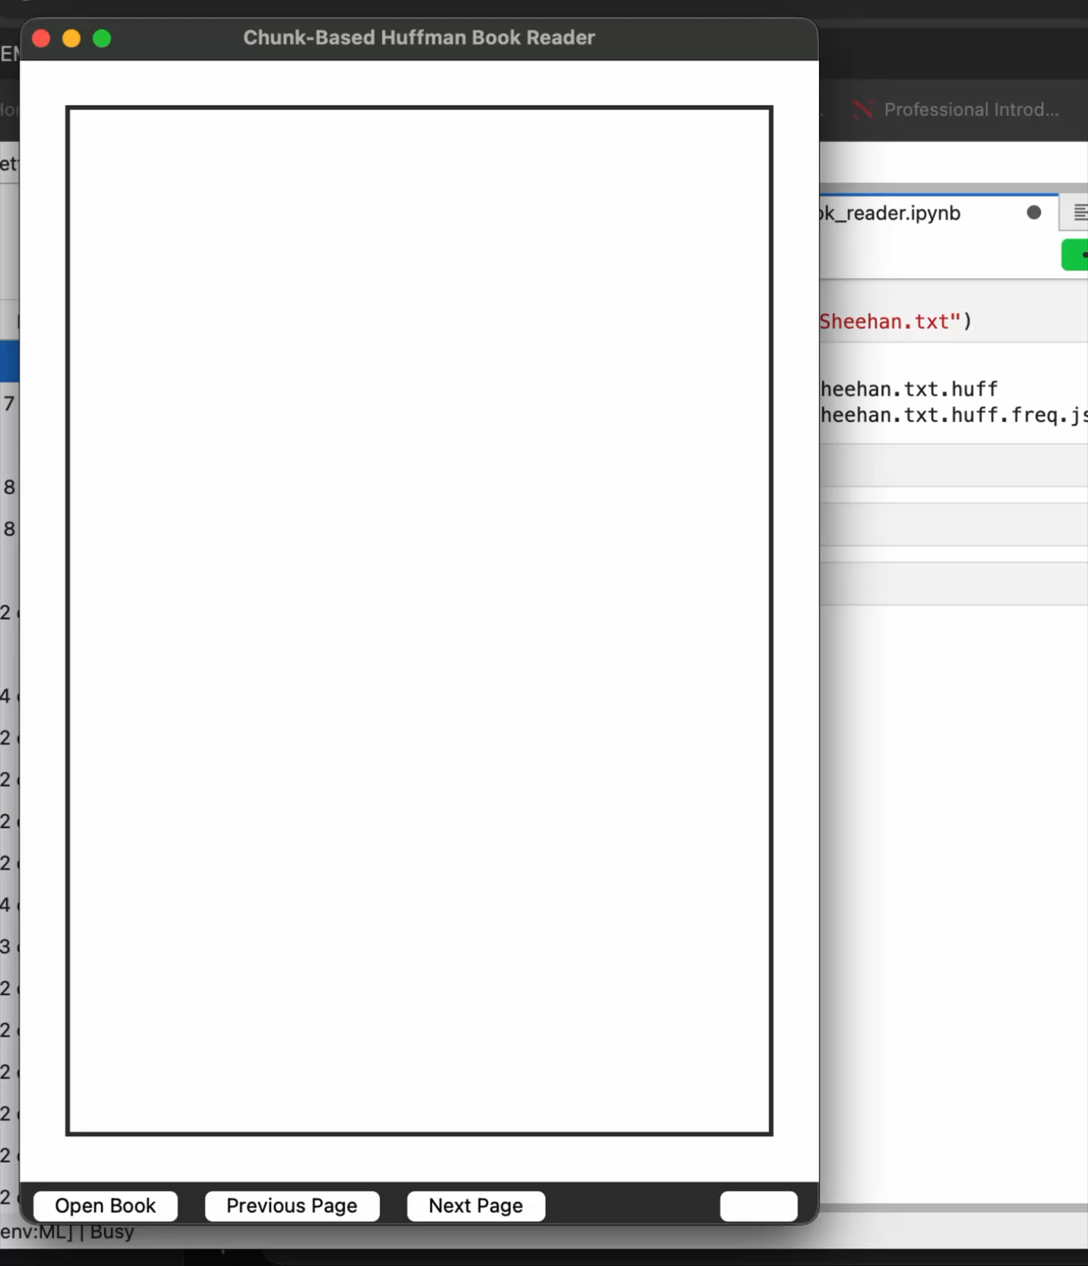
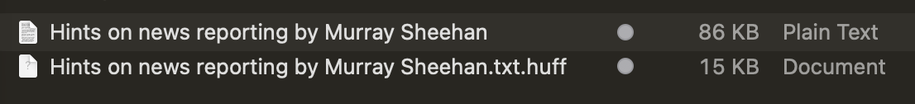
Huffman Coding
CS5800 Algorithms | Northeastern University
Reader application
Python Tkinter GUI
Paper like reading experience
Chunks of 250 words decoded per page
Page Navigation controls
Load books with .huff and .json metadata file

Slide 10
Huffman Coding
CS5800 Algorithms | Northeastern University
Observations
More repetition → better compression. Larger books shows higher compression ratio
Huffman coding efficiency depends on frequency distribution
Worst-case for char: no gain, overhead may slightly increase size. Word level encoding outperforms in any case.
Visual tree helps understand code assignment
Reader works in memory, no physical/temporary files created
Page by Page/chunk wise decompression handles large files efficiently
Optional files can be skipped to save memory – png tree, codes etc.

Slide 11
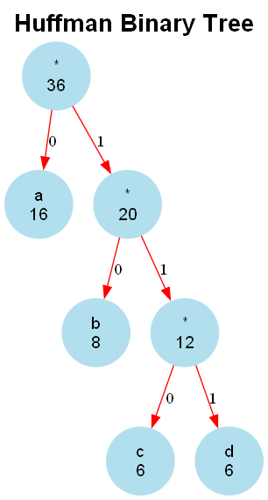
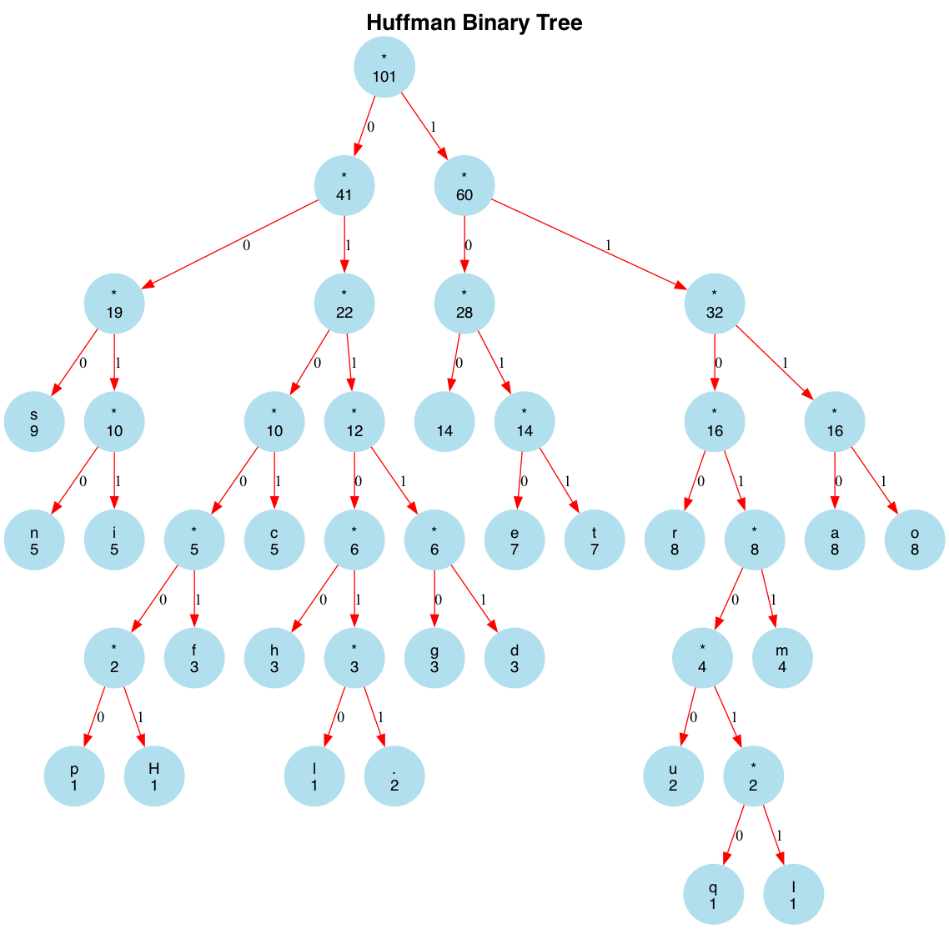
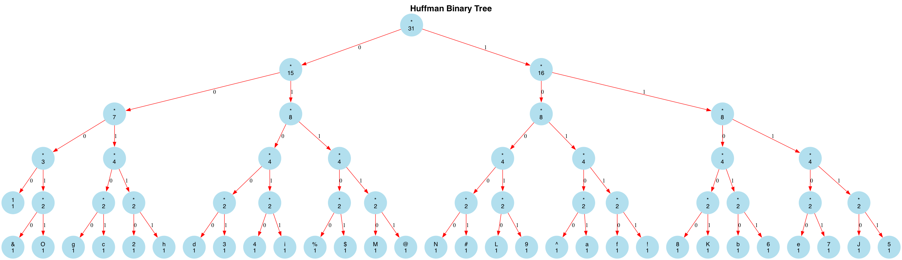
Huffman Coding
CS5800 Algorithms | Northeastern University
Test Cases - Char
Average case Example:
"Huffman coding is a data compression algorithm. It assigns shorter codes to more frequent characters.”
Best case Example: "aaaaaaaaaaaaaaaabbbbbbbbccccccdddddd”
Worst case Example:
"abcdefghiJKLMNO123456789!@#$%^&”
Huffman Encoding Report (Character-Level)
Original Text Length: 36 tokens
Symbol Table:
Symbol | Frequency | Huffman Code | Bits Used
=================================================
a | 16 | 0 | 16
b | 8 | 10 | 16
c | 6 | 110 | 18
d | 6 | 111 | 18
=================================================
Original size (bits): 288
Compressed size (bits): 68
Compression ratio: 76.39%
Unique symbols: 4
Most frequent symbol: 'a' (16 times)
Least frequent symbol: 'c' (6 times)
Huffman Encoding Report (Character-Level)
Original Text Length: 101 tokens
=======================================
Original size (bits): 808
Compressed size (bits): 417
Compression ratio: 48.39%
Unique symbols: 22
Most frequent symbol: ' ' (14 times)
Least frequent symbol: 'H' (1 times)
Huffman Encoding Report (Character-Level)
Original Text Length: 31 tokens
============================================
Original size (bits): 248
Compressed size (bits): 154
Compression ratio: 37.90%
Unique symbols: 31
Most frequent symbol: 'a' (1 times)
Least frequent symbol: 'a' (1 times)

Slide 12
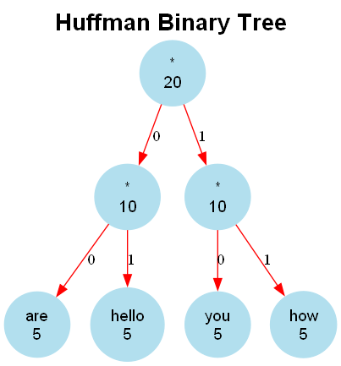
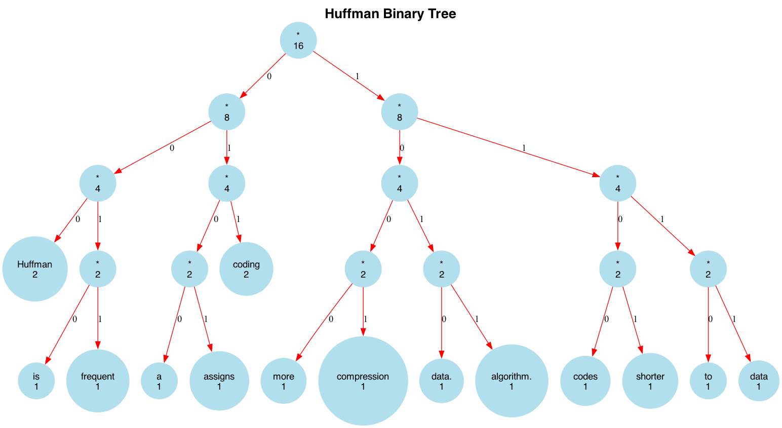
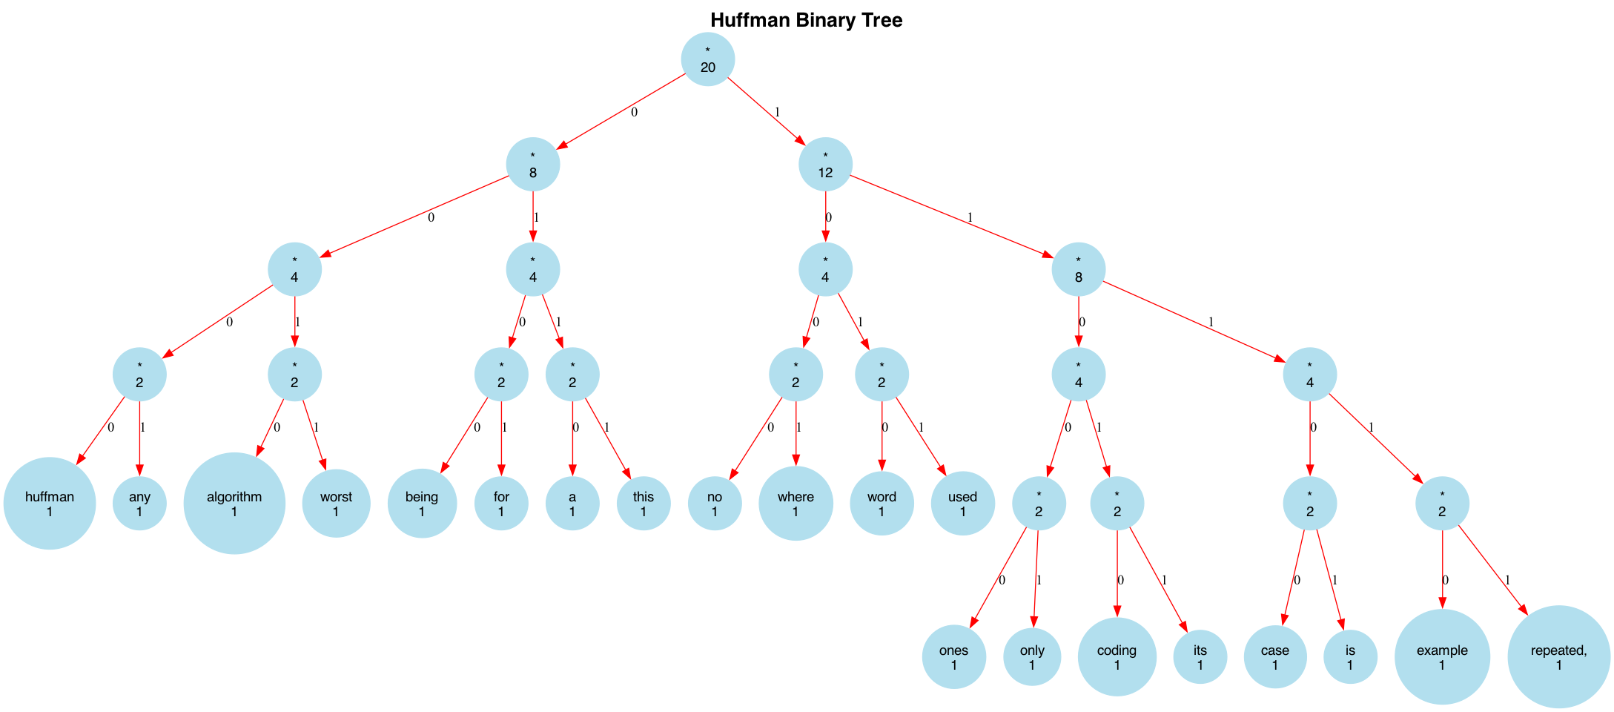
Huffman Coding
CS5800 Algorithms | Northeastern University
Test Cases - Word
Best case Example:
"hello how are you hello how are you hello how are you hello how are you hello how are you”
Best case Example:
"Huffman coding is a data compression algorithm. Huffman coding assigns shorter codes to more frequent data.”
Worst case Example:
"this is a worst case example for huffman coding algorithm where no any word being repeated, its used only ones”
Huffman Encoding Report (Word-Level)
Original Text Length: 20 tokens
Symbol Table:
Symbol | Frequency | Huffman Code | Bits Used
===============================================
are | 5 | 00 | 10
hello | 5 | 01 | 10
you | 5 | 10 | 10
how | 5 | 11 | 10
===============================================
Original size (bits): 320
Compressed size (bits): 40
Compression ratio: 87.50%
Unique symbols: 4
Most frequent symbol: 'hello' (5 times)
Least frequent symbol: 'hello' (5 times)
Huffman Encoding Report (Word-Level)
Original Text Length: 16 tokens
============================================
Original size (bits): 256
Compressed size (bits): 60
Compression ratio: 76.56%
Unique symbols: 14
Most frequent symbol: 'Huffman' (2 times)
Least frequent symbol: 'is' (1 times)
Huffman Encoding Report (Word-Level)
Original Text Length: 20 tokens
===============================================
Original size (bits): 320
Compressed size (bits): 88
Compression ratio: 72.50%
Unique symbols: 20
Most frequent symbol: 'this' (1 times)
Least frequent symbol: 'this' (1 times)

Slide 13




Huffman Coding
CS5800 Algorithms | Northeastern University
Conclusion
Implemented system
Reduces storage usage substantially
Correctly reconstructs text
Ensures fast page loading
Works well across multiple books
Huffman Coding is not just theoretical, it powers real systems
This project demonstrates complete integration from algorithm → compression → metadata → decoding → UI.
Shows how algorithm design, data structures and UX can combine to produce a working, practical application.
GIT link - https://github.com/bshind87/Huffman_tool.git

Slide 14
T H A N K Y O U

